Slide 1


Slide 2
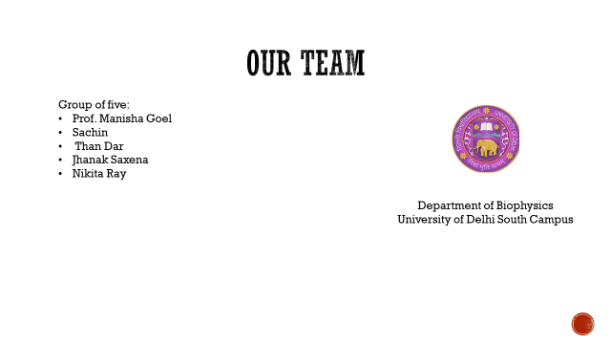

Slide 3
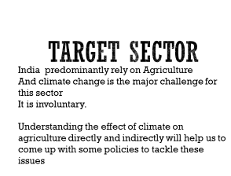
In doing so we are targeting IPCC chapters.
WG1
WG2
SRCCL
SR15

Slide 4
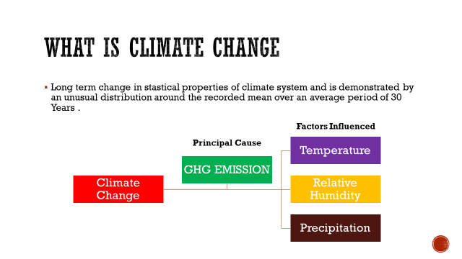

Slide 5
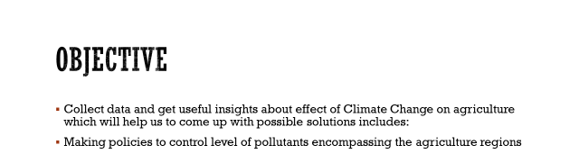

Slide 6
APPROACH
Collecting information
Looking for associated organisation
Looking for other associated factors
Generating wordcloud with online tools
Information about IPCC reports using pygetpapers:
WG1
WG2
SR15
SRCCL
Shortlisting organization using docanalysis
Converting PDF to txt using Pyamihtmlx incorporated in our script

Slide 7
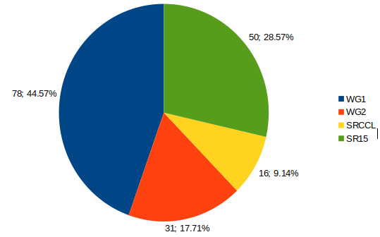
Data stats : Number of articles we found

Slide 8
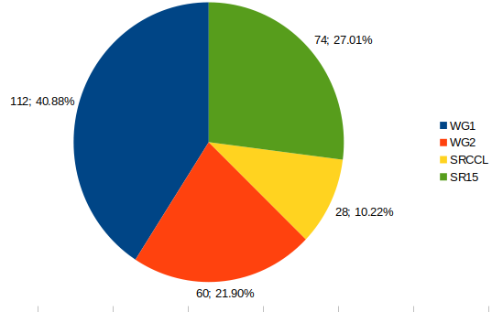
Number of organization we found working

Slide 9
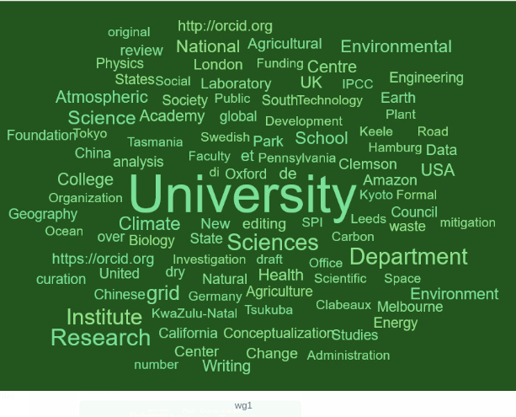
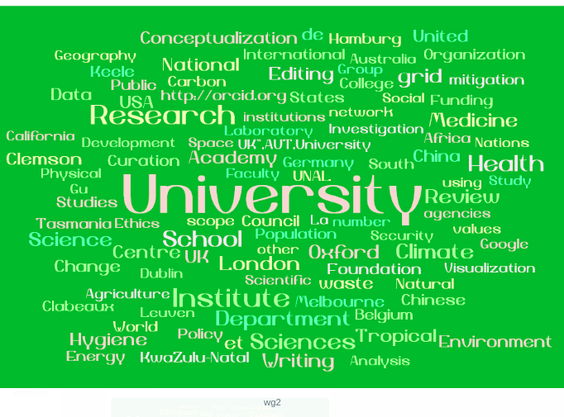
Organization

Slide 10
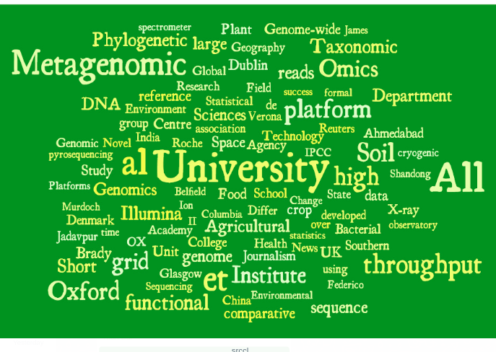
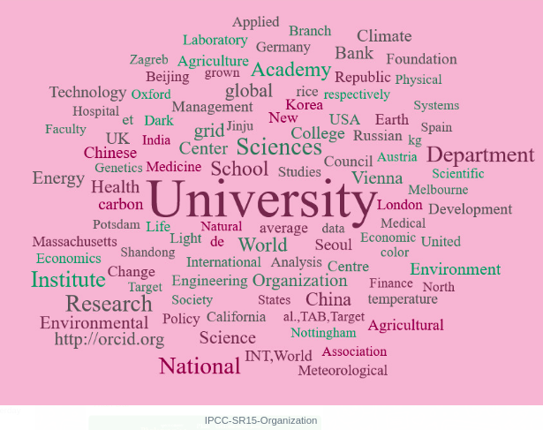
13

Slide 11
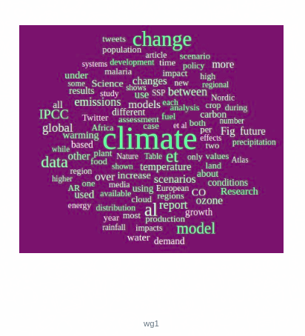
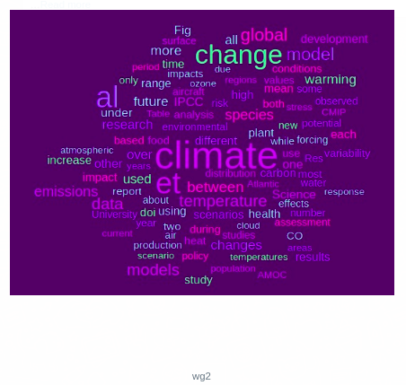
Other factor

Slide 12
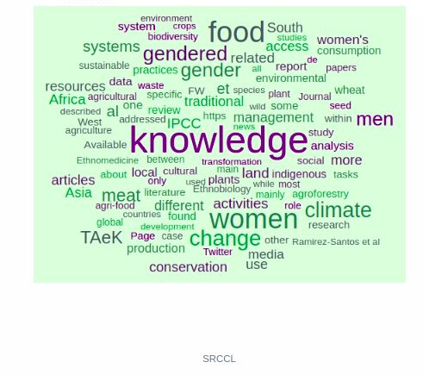
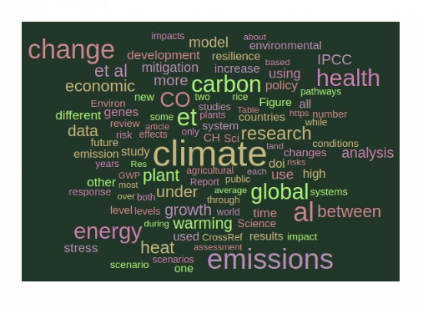

Slide 13
THANK YOU!

